Slide 1
9.19
9.26
9.28
10.4
10.9
10.19
10.26
. . .
Come + visit with us!
Come + visit with us!
2023
FALL
CAREER
FAIRS
www.
Connect with us:
.

Slide 2
#
6
7
GIANTS 400 REPORT

Slide 3
Design With
Come Work For Us

Slide 4
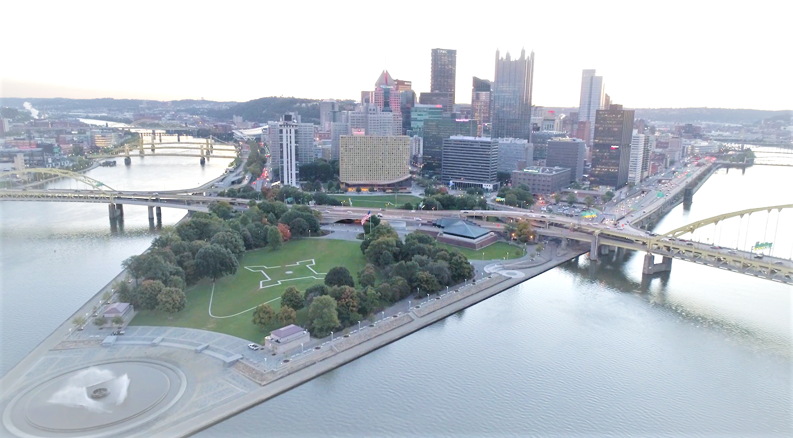
LIFE IS SHORT.
WORK SOMEWHERE AWESOME.
Z
WE’RE HIRING!
PITTSBURGH, PA | JOHNSTOWN, PA | YOUNGSTOWN, OH
FREDERICK, MD | ERIE, PA | MORGANTOWN, WV | BALTIMORE, MD
PITTSBURGH, PA
JOHNSTOWN, PA | YOUNGSTOWN, OH | FREDERICK, MD | ERIE, PA | MORGANTOWN, WV | BALTIMORE, MD
cjlengineering.com
#thecjlteam
www.
__________________________________

Slide 5
LIFE IS SHORT.
WORK SOMEWHERE AWESOME.
Z
WE’RE HIRING!
PITTSBURGH, PA | JOHNSTOWN, PA | YOUNGSTOWN, OH
FREDERICK, MD | ERIE, PA | MORGANTOWN, WV | BALTIMORE, MD
PITTSBURGH, PA
JOHNSTOWN, PA | YOUNGSTOWN, OH | FREDERICK, MD | ERIE, PA | MORGANTOWN, WV | BALTIMORE, MD
cjlengineering.com
#thecjlteam
W W W. E N G I N E E R I N G . C O M

Slide 6
LIFE IS SHORT.
WORK SOMEWHERE AWESOME.
Z
WE’RE HIRING!
PITTSBURGH, PA | JOHNSTOWN, PA | YOUNGSTOWN, OH
FREDERICK, MD | ERIE, PA | MORGANTOWN, WV | BALTIMORE, MD
PITTSBURGH, PA
JOHNSTOWN, PA | YOUNGSTOWN, OH | FREDERICK, MD | ERIE, PA | MORGANTOWN, WV | BALTIMORE, MD
cjlengineering.com
#thecjlteam
www.
__________________________________

Slide 7
Want a new job to complain about?
Flexible Schedule with Half-Day Fridays
Paid Week Off the Last Week of the Year
Awesome Benefits
Generous Paid Time Off
Low Turnover Rate in the Industry
*Interested in becoming a part of #thecjlteam, but don’t see
a job post that matches your qualifications? We have a link just for that!
cjlengineering.com/careers
Design With
Come Work For Us
www.

Slide 8
Become a problem solver.
Endless opportunities.
Endless possibilities.
Connect
with us!
www.
#thecjlteam
__________________________________

Slide 9
Become a problem solver.
Endless opportunities.
Endless possibilities.
Connect
with us!
www.
#thecjlteam
__________________________________

Slide 10
Want
a new job to
complain about?
Awesome Benefits
Generous Paid Time Off
Low Turnover Rate in the Industry
Flexible Schedule w/ Half-Day Fridays
Paid Week Off the Last Week of the Year
Interested in becoming a part of #thecjlteam, but don’t see a job
post that matches your qualifications? Check out cjlengineering.com/careers
Quality People
Flexible Schedule
* Named to the 2022 Pittsburgh Post Gazette Top Workplaces
Design With
Come Work For Us
www.

Slide 11
Want
a new job to
complain about?
Quality People
Flexible Schedule
Awesome Benefits
Generous Paid Time Off
Low Turnover Rate in the Industry
Flexible Schedule w/ Half-Day Fridays
Paid Week Off the Last Week of the Year
Design With
Come Work For Us
www.

Slide 12
Want a new job to complain about?
Half-Day Fridays
Paid Week Off In-Between Holidays
Awesome Benefits
Generous Time Off
Low Turnover Rate in the Industry
*Interested in becoming a part of #thecjlteam, but don’t see
a job post that matches your qualifications? We have a link just for that!
cjlengineering.com/careers
Design With
Come Work For Us
www.

Slide 14
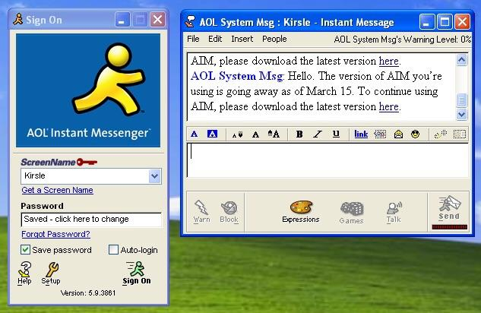
sdfgsdg
CJL Candidate

Slide 16
Connect
with us!
www.
#thecjlteam
Become a problem solver.
Endless opportunities.
Endless possibilities.
__________________________________

Slide 17
Connect
with us!
Become a problem solver.
Endless opportunities.
Endless possibilities.
www.
#thecjlteam
__________________________________

Slide 18
Connect
with us!
Become a problem solver.
Endless opportunities.
Endless possibilities.
www.
#thecjlteam
__________________________________

Slide 19
Become a problem solver.
Endless opportunities.
Endless possibilities.
#thecjlteam
__________________________________

Slide 20
Thank an engineer today

Slide 21
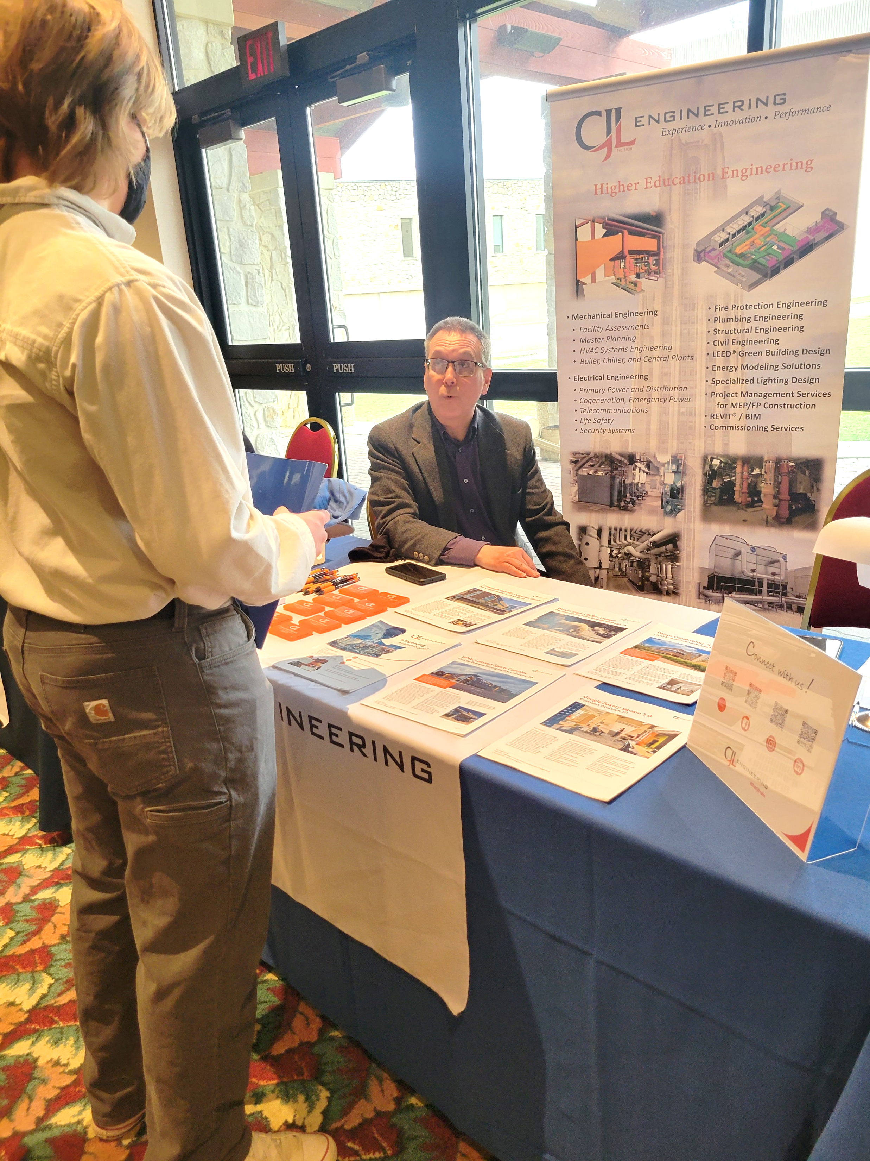
CAREER
FAIR
- - - - - - - - - - - -
- - - WE’RE HIRING!

Slide 22
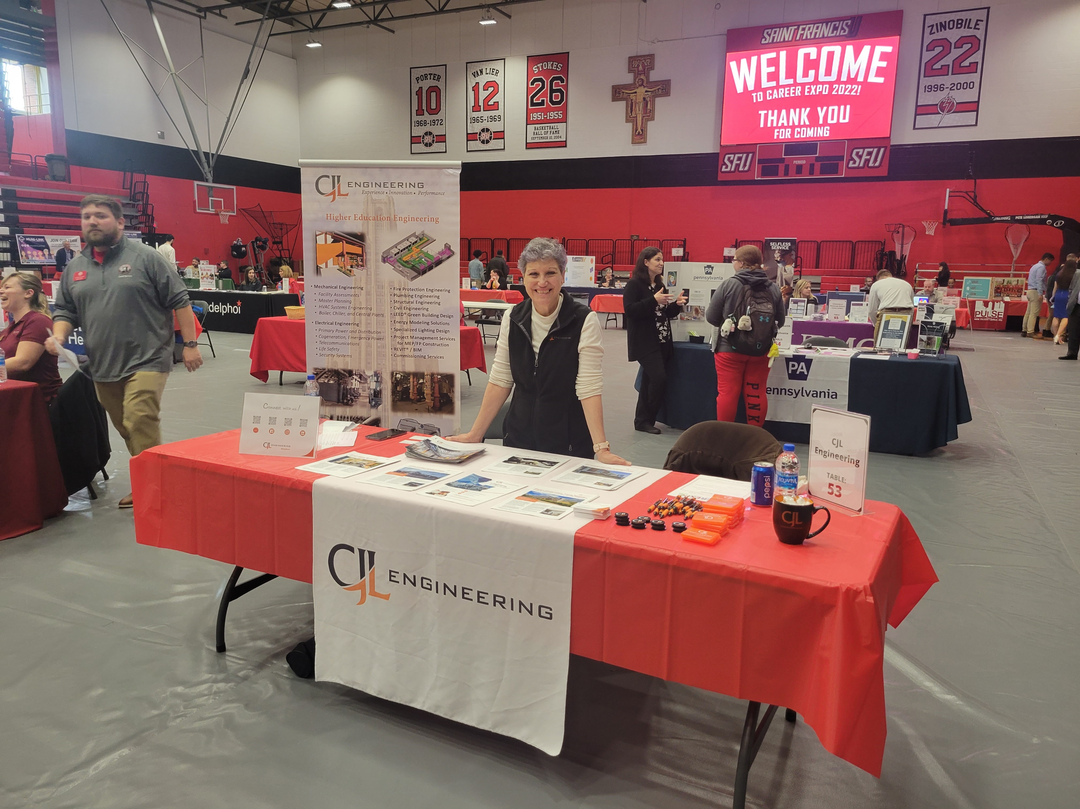
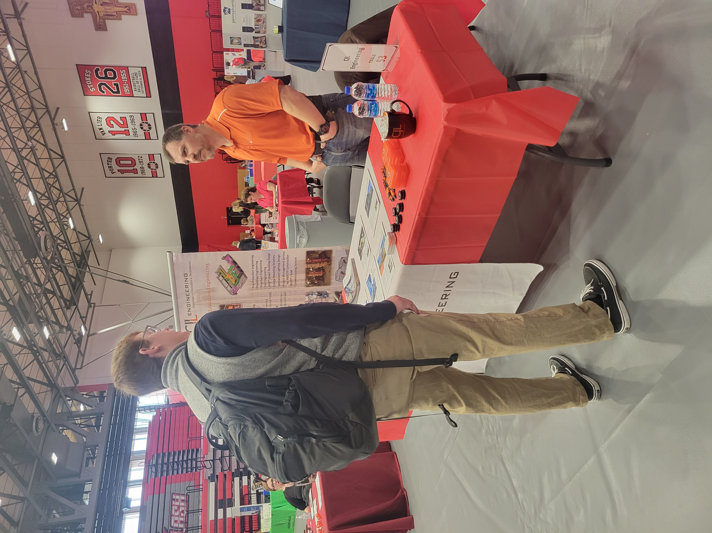
CAREER
FAIR
- - - - - - - - - - - -
- - - WE’RE HIRING!

